Slide 1
Feature Selection Algorithms
All about images and stories.

Slide 2
Learning Outcomes
Understand and Apply Basic Photo Enhancements: Students will learn to perform essential photo enhancements, such as brightening and adding vibrancy to specific elements like eyes in a portrait, using Adobe Photoshop. This outcome ensures they can elevate the quality of digital images through subtle but effective edits.
Learn the Technique of Posterization: Students will gain proficiency in posterizing images to create a vintage or stylized effect by reducing the number of colors and adjusting brightness levels. This outcome focuses on helping students understand how to manipulate images creatively while maintaining control over the final aesthetic.
Develop Skills in Layer Management and Masking: Students will learn how to organize their Photoshop projects using layers and apply effects selectively through layer masks. This outcome ensures students can manage complex edits effectively and refine their work to achieve professional-quality results.

Slide 3
Part 1: Basic Photo Enhancements & Effects

Slide 4


1. The Eyes are the Window to the Soul
Brighten and Enhance Eyes in Photoshop
Learn how to make eyes sparkle and add life to your portraits.
Use a simple, quick technique that is perfect for beginners.
Elevate your portrait photography with engaging, vibrant eyes.

Slide 5
Steps
Brighten and Enhance Eyes in Photoshop
Start by going to Photoshop's Layers panel and clicking the Add New Layer icon. Photoshop adds a new blank layer above your image.
By default, the new layer is named Layer 1 but rename it to Eyes.
In Photoshop’s toolbar, select the Brush Tool.
With the Brush Tool active, right-click anywhere on your image to open the Brush Preset Picker. Then select the Soft Round brush. In newer versions of Photoshop, the Soft Round brush is found in the General Brushes category. Press Enter (Win) / Return (Mac) to close the Brush Preset Picker.
Set your brush color to white. Make sure your Foreground color (which is also the brush color) is set to white. If it’s set to a different color, press the letter D on your keyboard to reset the Foreground and Background colors to their defaults (black for the Foreground and white for the Background). Then press X on your keyboard to swap them. The current Foreground and Background colors are shown in the color swatches in the toolbar. The Foreground color is the upper left swatch and should now be white.

Slide 6
Steps
Brighten and Enhance Eyes in Photoshop
Resize the brush. We can brighten both eyes at once on the same layer. Start with the left eye. Use the left and right bracket keys ( [ and ] ) on your keyboard to resize your brush cursor so that it’s slightly smaller than the iris (the color part of the eye that we want to brighten).
Click once on each iris - then click once in the lower right of the iris to add a big white blob. Do the same thing with the right eye using the same brush size, clicking once in the lower right of the iris to add the same white blob in the same spot.
Add a smaller area of white on the opposite sides. Press the right bracket key ( ] ) on your keyboard two or three times to make the brush cursor a bit smaller. Then click once in the upper left of the iris in each eye to add a second smaller white blob on the opposite side.
Add a layer mask. Back in the Layers panel, with the eyes layer selected, click the Add Layer Mask icon. A layer mask thumbnail appears on the eyes layer.
Set the Foreground color to black. The layer mask will be used to hide the white blobs in the pupils and the areas surrounding each iris, which means we need to paint on the layer mask with black. Make sure your Foreground color is set to black. If it’s set to white, press X on your keyboard to swap the Foreground and Background colors.

Slide 7
Steps
Brighten and Enhance Eyes in Photoshop
Hide the white from the pupils and surrounding areas. Again we’ll start with the left eye. Press the right bracket key ( ] ) on your keyboard to make the brush smaller until it is the same size as the pupil. Then click once in the center of the pupil to hide the white (by painting with black on the layer mask). Do the same thing for the right eye, clicking once in the center of the pupil to hide the white.
Then paint carefully around the outer edges of each iris to hide the white from the surrounding areas. Make sure to paint over the eyelashes as well. Do the same thing for the right iris. The white in each eye should now be visible only in the iris itself.
Change the layer blend mode to Overlay. Finally, back in the Layers panel, change the blend mode of the eyes layer from Normal to Overlay. The areas in each eye where we painted with white now appear brighter, adding a nice sparkle.

Slide 8
Takeaways
Brighten and Enhance Eyes in Photoshop
Creating Layers:
Add and rename layers for better organization.
Use layer masks to apply effects selectively.
Using the Brush Tool:
Choose the Soft Round Brush for smooth adjustments.
Resize the brush with keyboard shortcuts for accuracy.
Layer Masking:
Hide unwanted areas by painting with black on the layer mask.
Refine the mask to keep the effect only on the iris
Blend Modes:
Change the layer blend mode to Overlay for added brightness and sparkle.
Overlay Mode - enhances the contrast of an image by making the dark areas darker and the light areas lighter.
In simple terms:
Light colors get lighter.
Dark colors get darker.
It’s often used to add depth, contrast, or brightness to an image without losing detail.

Slide 9



2. Posterize
Learn to Posterize an Image in Photoshop
Posterizing reduces the number of colors in a photo to mimic the look of vintage posters.
Creates abrupt transitions between colors and brightness levels, instead of smooth gradations.
Gives the image a simplified, painted, or airbrushed appearance by reducing detail.

Slide 10
2. Posterize
Learn to Posterize an Image in Photoshop
In the Layers panel, the image appears on the Background layer. Click the New Fill or Adjustment Layer icon at the bottom of the Layers panel - then choose Posterize from the list. Photoshop adds the Posterize adjustment layer above the image. * with Levels set to 4, we're limiting the image to just 4 shades of red, 4 shades of green and 4 shades of blue, for a total of 64 possible colors (4x4x4).
Lower values produce a much stronger posterize effect. And with most images, a value of between 4 and 10 works well.
Change the blend mode to Luminosity (optional). If you would rather bring back the photo's original colors, simply change the blend mode of the Posterize adjustment layer from Normal to Luminosity.
* the Luminosity blend mode limits the effect to just the brightness values, leaving the original colors alone. It's really a personal preference

Slide 11
2. Posterize
Learn to Posterize an Image in Photoshop
Add a Levels adjustment layer. To gain a bit more control over the effect, add a Levels adjustment layer between the image and the Posterize layer.
In the Layers panel, click on the Background layer to select it - then click the New Fill or Adjustment Layer icon at the bottom - and this time choose Levels.
Drag the midtone slider. In the Properties panel, look for the midtone slider below the middle of the histogram. Drag the slider left or right. Dragging to the left will push more of the effect into the lighter tones and dragging the slider to the right brings out more of the darker tones.
Group the two adjustment layers. In the Layers panel, click on one of the adjustment layers to select it. Then hold the Shift key on your keyboard and click on the other adjustment layer to select them both - With both layers selected, click the Layers panel menu icon and choose New Group from Layers. Name the group Posterize and click OK.

Slide 12
2. Posterize
Learn to Posterize an Image in Photoshop
Turn off the group and select the image layer. Turn the effect off for the moment, just so we can see our original image, by clicking the group's visibility icon. Then click on the image (background) layer to make it active.
Choose Select Subject. Go up to the Select menu in the Menu Bar and choose Subject.
Select and turn on the Posterize group.
Add a layer mask to the group. Click the Add Layer Mask icon at the bottom of the Layers panel.
Clean up the layer mask if needed. In the Layers panel, we see the layer mask thumbnail that was added to the group. The white area on the mask was the area we selected and where the effect is visible. The black area was everything outside the selection and where the effect is hidden.
Hold the Alt key on a PC or the Option key on a Mac and click on the layer mask thumbnail.
Paint on the layer mask to add or subtract areas. If there were any parts of your subject that the Select Subject command missed, or if there are any parts of the background that need to be removed from the effect, just grab the Brush Tool from the toolbar.
Then paint with white on the layer mask to add an area to the effect, or paint with black to remove an area from the effect. Use the left and right bracket keys ( [ and ] ) on your keyboard to adjust the size of your brush as needed.

Slide 13
Part 2: Storytelling Models
SPOILER WARNING!

Slide 14
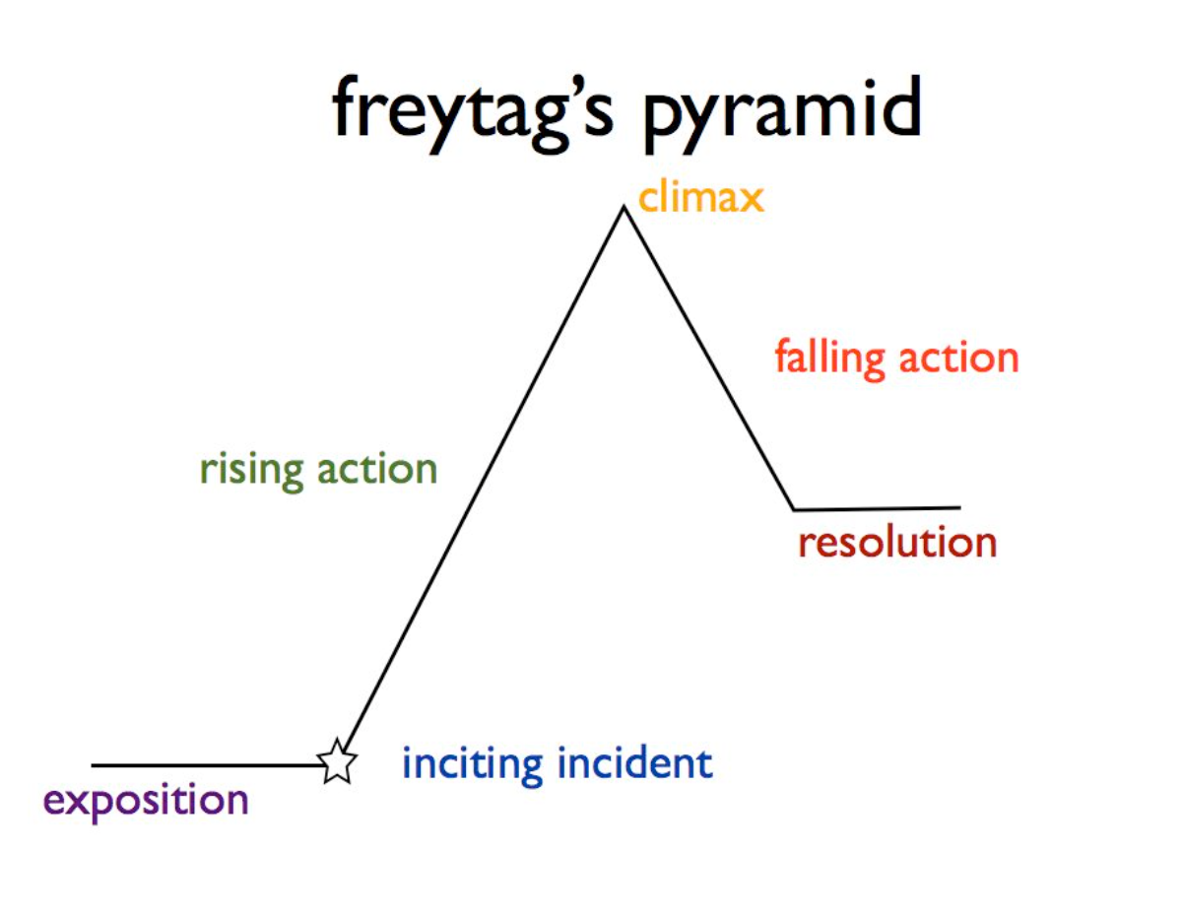
1. Freytag’s Pyramid
Also known as Freytag's Triangle, is a model for storytelling that breaks down the structure of a narrative into five distinct parts. This model was introduced by the German playwright Gustav Freytag.
Freytag's Pyramid is particularly effective for analyzing traditional, linear narratives, especially in classical drama and literature. However, it can be adapted to fit different types of storytelling, including more modern, non-linear narratives.

Slide 15
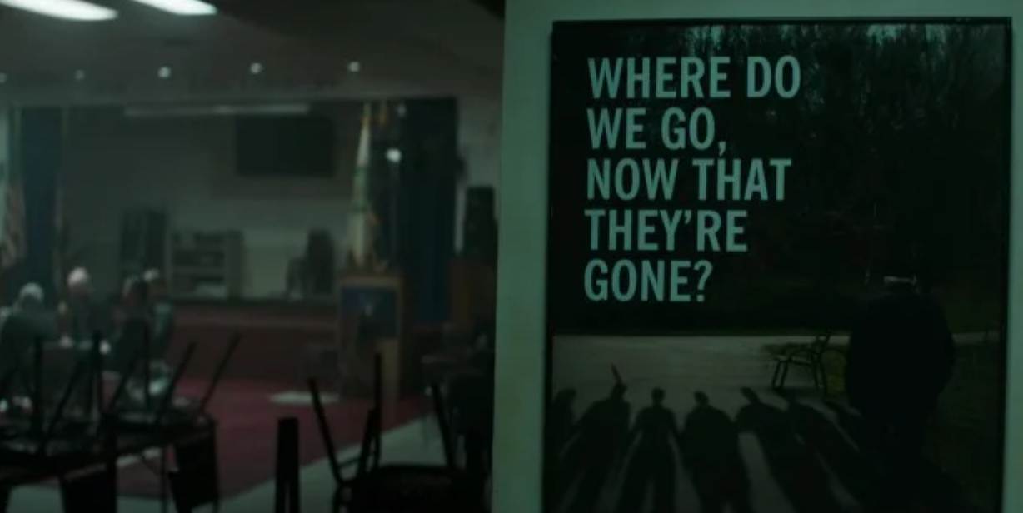
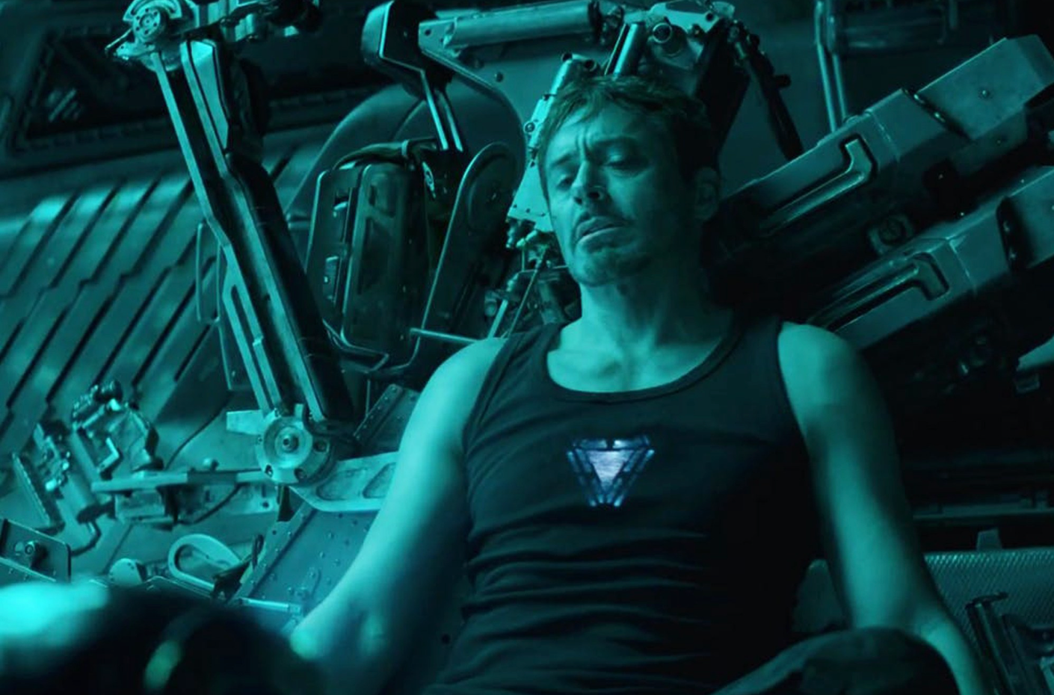
Exposition
Purpose: Introduce the story’s background information.
Content: This is where the setting, characters, and initial situation are introduced. The audience gets to know the protagonist and other key characters, the location, and the time period of the story. It sets the stage for the action to come.
Notes:
In Avengers: Endgame, the narrative can be analyzed using Freytag’s Pyramid, which highlights the structure of the story. Here’s how each part of the film fits into the model:
1. Exposition:
Purpose: Introduce the setting, characters, and initial situation.
Content: The film begins with a world devastated by Thanos’ snap, which wiped out half of all life in the universe. The surviving Avengers are introduced in a state of grief and loss. We see how the snap has affected the world, with characters like Tony Stark stranded in space, and the remaining Avengers struggling to cope with their failure. The exposition sets up the main conflict: the heroes' desire to undo the damage caused by Thanos.

Slide 16

Rising Action
Purpose: Build tension and develop the story.
Content: In this part, the central conflict or problem begins to unfold. The protagonist faces challenges or obstacles that create suspense and propel the story forward. Each event or complication in the rising action heightens the stakes and deepens the conflict.
Notes:
Rising Action:
Purpose: Develop the conflict and build tension.
Content: The rising action begins when Scott Lang (Ant-Man) returns from the Quantum Realm and proposes the idea of a "time heist" to retrieve the Infinity Stones from the past and reverse Thanos' snap. The Avengers regroup and plan the time heist, each team traveling to different points in time to collect the stones. Tension builds as they face various challenges in retrieving the stones, including battles, emotional encounters, and close calls.

Slide 17
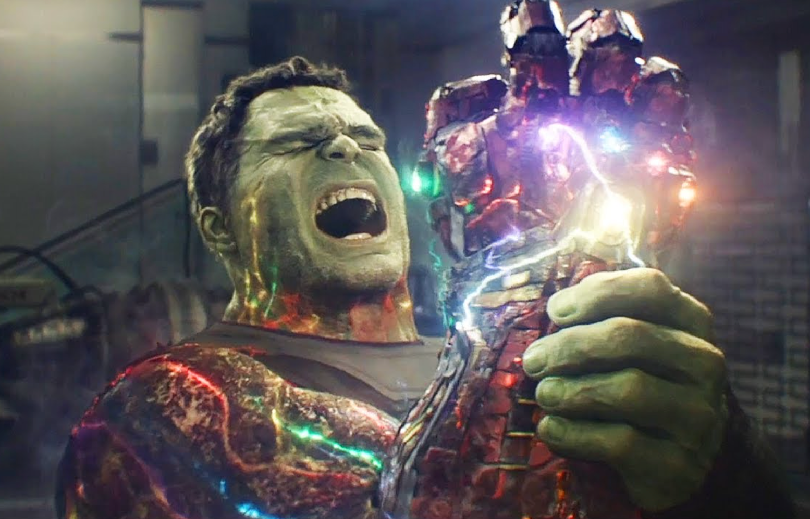

Climax
Purpose: Reach the peak of the story’s tension.
Content: The climax is the turning point of the story, where the tension reaches its highest point. This is usually the most exciting or intense moment, where the protagonist confronts the central conflict head-on. The outcome of this confrontation determines the direction of the rest of the story.
Notes:
Climax:
Purpose: Reach the peak of the story’s tension.
Content: The climax occurs when the Avengers successfully gather all the Infinity Stones and Hulk snaps his fingers, bringing back everyone who was lost. However, this is immediately followed by Thanos from the past discovering their plan and launching an all-out attack on the Avengers' compound. The ultimate confrontation takes place when Thanos and his army battle the Avengers and their newly resurrected allies. The tension peaks when Tony Stark sacrifices himself by using the Infinity Stones to erase Thanos and his forces from existence.

Slide 18


Falling Action
Purpose: Resolve the conflict.
Content: After the climax, the story begins to wind down. The falling action deals with the consequences of the protagonist's decisions or actions at the climax. The tension decreases as the story moves toward its conclusion, and the various loose ends start to be tied up.
Notes:
4. Falling Action:
Purpose: Resolve the conflict.
Content: After Thanos and his army are defeated, the falling action deals with the aftermath of the battle. The heroes mourn the loss of Tony Stark, who gave his life to save the universe. The surviving characters begin to return to their lives, trying to find a new sense of normalcy. The film also addresses other loose ends, such as Steve Rogers (Captain America) returning the stones to their rightful places in time.

Slide 19


Denouement (Resolution)
Purpose: Bring the story to a close.
Content: The denouement is where the story concludes. The final outcome of the conflict is revealed, and the characters' fates are sealed. It provides a sense of closure to the audience, resolving any remaining subplots or questions.
Notes:
5. Denouement (Resolution):
Purpose: Bring the story to a close.
Content: The denouement focuses on the resolution of the characters' arcs. Steve Rogers decides to stay in the past and live out his life with Peggy Carter, passing on his shield to Sam Wilson (Falcon) to become the new Captain America. The film ends with a sense of closure for many of the characters, reflecting on the sacrifices made and the new beginnings that lie ahead for the surviving heroes. In Avengers: Endgame, Freytag’s Pyramid helps break down the complex and emotional journey of the characters as they struggle with loss, redemption, and ultimately, victory, making it a fitting example of this classical narrative structure.

Slide 20
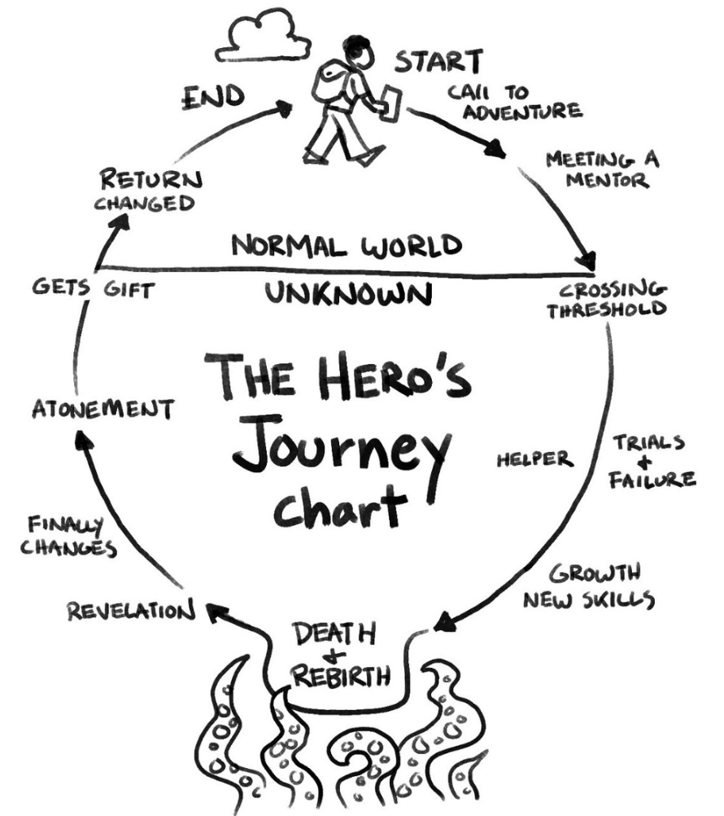
2. The Hero’s Journey
Also known as the Monomyth, is a narrative structure identified by the mythologist Joseph Campbell. Campbell observed that many myths, stories, and legends across different cultures follow a similar pattern, where a hero undergoes a transformative adventure. This structure is divided into stages that the hero passes through, each contributing to their ultimate growth and transformation. The Hero's Journey is typically divided into three main sections: Departure, Initiation, and Return.

Slide 21
Departure (Separation)
The Ordinary World:
Description: The hero’s normal life before the adventure begins. This stage sets the context, showing the hero's everyday environment, their relationships, and their flaws or challenges.
The Call to Adventure:
Description: The hero is presented with a challenge, problem, or adventure that disrupts their normal life. It’s the first sign that change is coming.
Refusal of the Call:
Description: The hero may initially refuse the call due to fear, insecurity, or a sense of duty to stay in their current life. This stage reflects the hero's hesitation to step into the unknown.
Meeting with the Mentor:
Description: The hero encounters a mentor who provides guidance, advice, or magical aid to help them on their journey. The mentor often provides the hero with something they need to succeed.
Crossing the Threshold:
Description: The hero commits to the adventure and leaves their ordinary world, crossing into the unknown, often represented by a physical boundary or significant change in setting.
Tests, Allies, and Enemies:
Description: The hero faces challenges, meets allies who assist them, and confronts enemies that hinder their progress. These experiences help the hero grow stronger and learn the rules of the special world.
This section involves the hero leaving their ordinary world and venturing into the unknown.
Notes:
The Ordinary World:
Description: Loki, a god from Asgard, has always lived in a world of manipulation and power. His "ordinary world" is a life of scheming, as seen in the Avengers movie, where he is captured by the Avengers after trying to conquer Earth.
In the Series: Loki's ordinary world shifts when he escapes with the Tesseract during the events of Avengers: Endgame, leading to an alternate timeline.
The Call to Adventure:
Description: Loki’s call to adventure begins when he is captured by the Time Variance Authority (TVA) after using the Tesseract to escape. The TVA informs him that he is a "variant" and must help them fix the timeline.
In the Series: Loki is presented with a choice: be erased from existence or help the TVA track down another variant of himself.
Refusal of the Call:
Description: Initially, Loki is resistant to the TVA's authority, skeptical of their power and the idea of helping them.
In the Series: Loki tries to escape the TVA and even attempts to outsmart them, refusing to cooperate fully.
Meeting with the Mentor:
Description: Loki meets Mobius M. Mobius, a TVA agent who becomes a mentor figure, offering Loki a different perspective on his life and choices.
In the Series: Mobius shows Loki a reel of his life, including events that haven't happened to this variant yet, leading to a moment of introspection.
Crossing the Threshold:
Description: Loki commits to the adventure by agreeing to help Mobius and the TVA track down the rogue variant.
In the Series: Loki steps into his new role within the TVA, working alongside Mobius to pursue the mysterious variant, later revealed to be Sylvie.
Tests, Allies, and Enemies:
Description: Loki faces various tests, makes allies, and encounters enemies as he navigates this new world.
In the Series: Loki forms an alliance with Sylvie, the rogue variant, while also dealing with the TVA’s manipulations. He confronts his own nature and motivations, questioning who he truly is. The TVA itself, along with its enigmatic leader, the Time-Keepers (later revealed to be a facade), serve as both obstacles and antagonists.

Slide 22
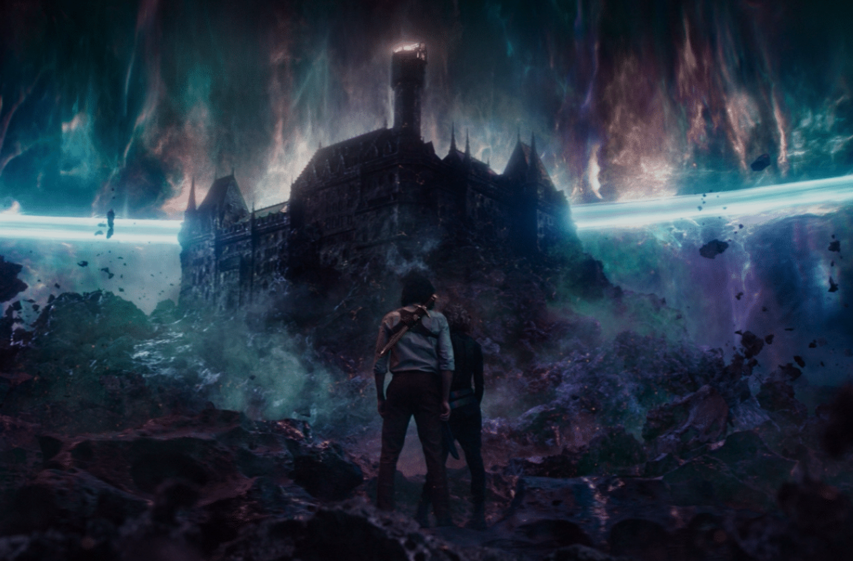
Initiation
This section covers the hero's actual journey in the unfamiliar world,
where they face and overcome significant trials.
Approach to the Inmost Cave:
Description: The hero approaches a dangerous place or situation where the central conflict resides. This is often a moment of preparation before facing the ultimate challenge.
The Ordeal:
Description: The hero faces a major challenge, often a life-or-death situation. This is the critical moment where the hero confronts their greatest fear or the main antagonist.
The Reward:
Description: After overcoming the ordeal, the hero earns a reward. This could be a physical treasure, knowledge, reconciliation, or even personal growth.
Notes:
Approach to the Inmost Cave:
Description: Loki and Sylvie approach the heart of the conflict by uncovering the truth about the TVA.
In the Series: The journey takes them to the Void and ultimately to the Citadel at the End of Time, where they meet He Who Remains, the true mastermind behind the TVA.
The Ordeal:
Description: Loki faces a critical challenge that tests his character and beliefs.
In the Series: The ordeal occurs when Loki and Sylvie confront He Who Remains. They are faced with a choice: kill him and unleash chaos by freeing the timeline, or take over his role to maintain order. Loki wrestles with the decision, recognizing the magnitude of the consequences.
The Reward:
Description: After the ordeal, the hero receives a reward, which can be knowledge, power, or personal growth.
In the Series: Loki’s reward is a deeper understanding of himself and the nature of free will, as well as a genuine connection with Sylvie. However, the reward is bittersweet, as Sylvie’s choice to kill He Who Remains sets off the multiverse, fracturing their alliance.

Slide 23
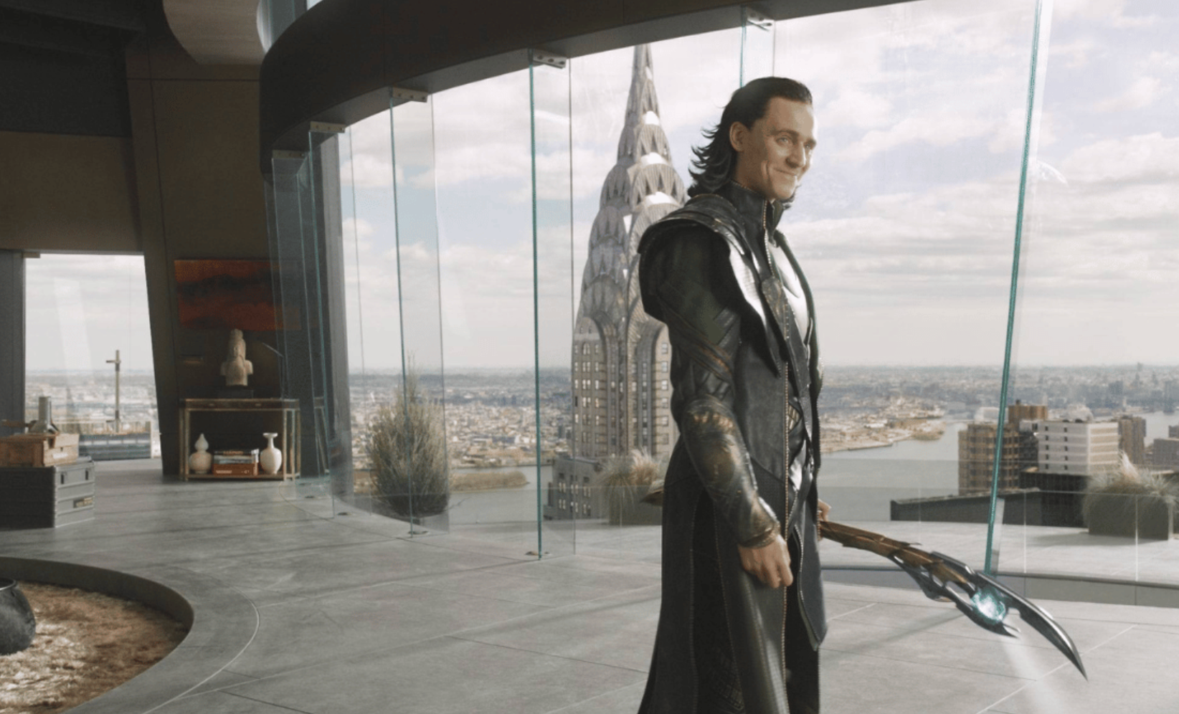
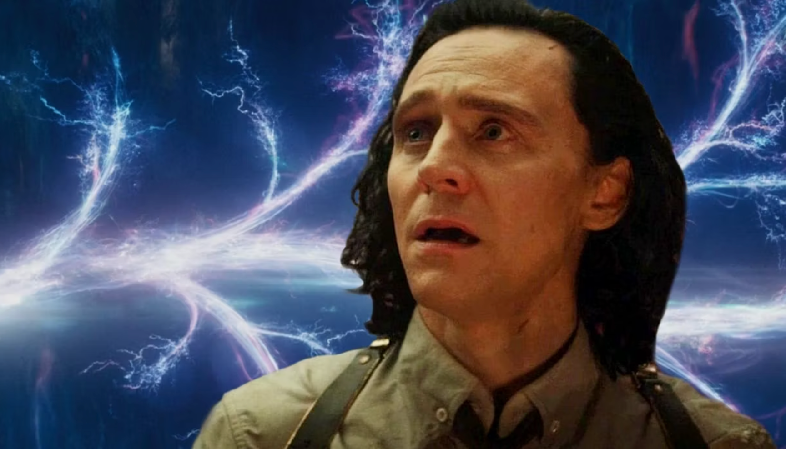
Return
In this section, the hero returns to their ordinary world, transformed by their experiences.
The Road Back:
Description: The hero begins the journey back to their ordinary world, often facing challenges or pursuing new goals. There may be a chase or pursuit as the hero attempts to return home.
The Resurrection:
Description: The hero faces a final test or challenge upon returning home. This is a climactic moment where the hero must use everything they've learned to overcome this ultimate trial
Return with the Elixir:
Description: The hero returns to their ordinary world, but they are transformed by their journey. They bring back something that can help others, whether it’s an actual treasure, newfound wisdom, or personal growth
Notes:
The Road Back:
Description: The hero begins the journey back to their ordinary world, often facing new challenges.
In the Series: Loki is sent back to the TVA, but he finds himself in a different reality where no one, including Mobius, remembers him. This signals the start of a new challenge as he realizes the TVA is now under the control of a variant of He Who Remains (later revealed to be Kang the Conqueror).
The Resurrection:
Description: The hero faces a final test where they are reborn or transformed, often symbolically.
In the Series: Loki’s resurrection comes through his transformation from a self-serving trickster to someone who genuinely cares about others and is willing to fight for the greater good, even if it means personal sacrifice. He is no longer the same Loki from the beginning of the series.
Return with the Elixir:
Description: The hero returns to the ordinary world, but they are changed by their experiences. They often bring back something valuable to their world.
In the Series: Loki’s "elixir" is his new understanding of the multiverse and the dangers it poses. He is now motivated to prevent the chaos unleashed by Sylvie’s actions, but he faces the challenge of being in a world where his allies no longer recognize him. This sets up the continuing narrative for the next season.
Summary
In Loki, the Hero's Journey is evident as the character undergoes significant growth and transformation. He starts as a villainous, self-centered god and evolves into a more self-aware, compassionate, and heroic figure who understands the complexities of the multiverse and the consequences of free will. The series uses this structure to explore deep themes of identity, choice, and destiny, while also setting up the broader implications for the Marvel Cinematic Universe.

Slide 24
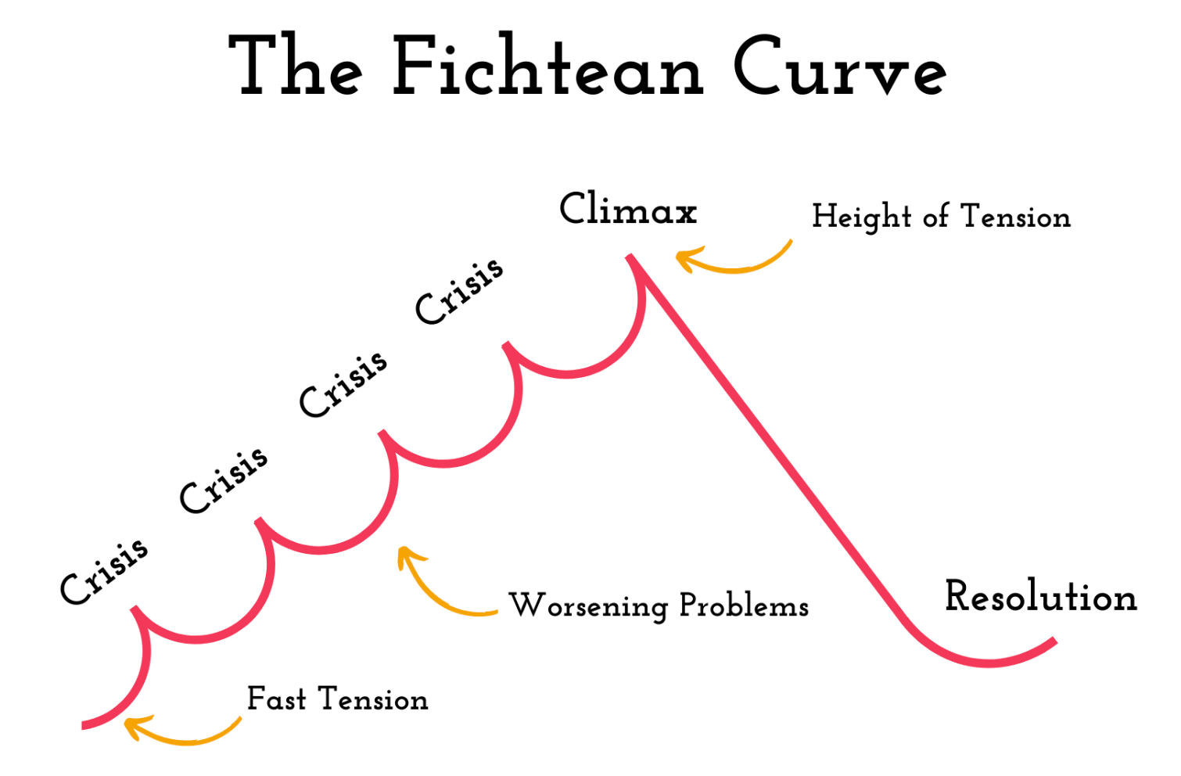

3. Fichtean Curve
Unlike traditional models like Freytag’s Pyramid, which has a clear beginning, middle, and end with a gradual rise and fall of tension, the Fichtean Curve focuses on a series of escalating crises that keep the audience engaged by continuously raising the stakes.
127 Hours is a strong example of the Fichtean Curve because it maintains high tension throughout the film with a series of escalating crises that the protagonist must face.
Notes:
Immediate Conflict
The film starts with Aron Ralston embarking on a solo adventure in Blue John Canyon, Utah. The initial conflict arises quickly when Aron slips and a boulder falls, trapping his arm against the canyon wall. This moment happens early in the film, thrusting the audience directly into the central conflict without much exposition.
Rising Action with Multiple Crises
First Crisis (Realization of Being Trapped): After the accident, Aron quickly realizes he is trapped with no immediate way to free himself. The initial shock and the reality of his situation set in, creating immediate tension.
Second Crisis (Limited Resources): Aron takes stock of his supplies—a small amount of water, some food, and a few tools. The realization that his resources are severely limited adds another layer of tension, as the audience understands the gravity of his situation.
Third Crisis (Failed Escape Attempts): Aron attempts various methods to free himself, including trying to chip away at the boulder with a small knife, rigging up a pulley system, and attempting to move the rock directly. Each of these attempts fails, escalating the sense of hopelessness and desperation.
Fourth Crisis (Physical Deterioration): As time passes, Aron begins to suffer from dehydration, exposure, and exhaustion. His physical condition deteriorates, further escalating the tension. The audience watches as Aron grows weaker, which amplifies the urgency of his situation.
Fifth Crisis (Psychological Strain): Aron's mental state begins to deteriorate as well. He experiences hallucinations, reflects on his life choices, and records messages for his family, knowing he may not survive. The psychological pressure mounts, adding emotional depth to the escalating crises.
Climax Near the End
The climax of the film occurs when Aron, in a moment of extreme desperation and clarity, decides to amputate his trapped arm using a dull knife. This is the most intense and harrowing moment in the film, representing the peak of the tension. The scene is both physically and emotionally excruciating, serving as the ultimate crisis in Aron's journey.
Falling Action and Resolution
After freeing himself, Aron stumbles through the canyon in search of help. Despite his severe injuries, he finally encounters other hikers who help him get rescued. This falling action is brief but intense, as the audience remains on edge until Aron's survival is assured.
The film concludes with a brief resolution, showing Aron’s recovery and how the experience changed his life, providing closure to the narrative.

Slide 25
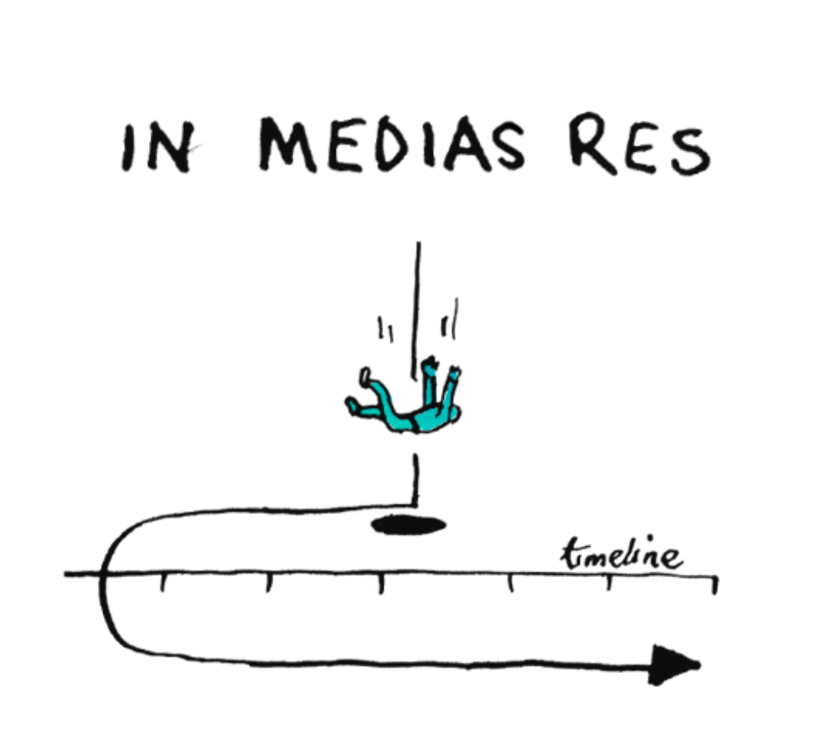

4. In Medias Res
A Latin phrase that means "in the midst of things." It is a narrative technique where a story begins in the middle of the action, rather than at the beginning of the chronological sequence of events.
Notes:
Starts in the Middle of the Action:
Memento opens with a shocking scene where the main character, Leonard, kills a man named Teddy. This happens right at the start, without any explanation of who Leonard or Teddy is, or why this is happening. The film immediately grabs your attention by starting at a critical moment.
2. Story Told Backwards:
The movie then unfolds in reverse order. Each scene shows what happened just before the previous one, moving backward in time. This unique structure means that instead of following the story from start to finish, you’re figuring out what led to the opening scene as the movie progresses.
3. Gradual Revelation:
As the movie goes on, you slowly learn more about Leonard, his memory loss, and why he’s hunting for the man he believes killed his wife. Because the story is told backward, you’re constantly piecing together the puzzle, just like Leonard, who can’t remember anything for more than a few minutes.
4. Creates Suspense and Engagement:
The In Medias Res approach and the backward storytelling keep you engaged and on the edge of your seat. You’re not just watching events unfold; you’re actively trying to understand how they connect, which builds suspense and makes the story more compelling.
5. Reflects the Theme of Memory:
The way the story is told mirrors Leonard’s experience with memory loss. Just as he struggles to make sense of his situation with only bits and pieces of information, the audience does too. This makes the film’s theme of memory and identity even more powerful.
In summary, Memento uses In Medias Res by starting with a dramatic event and then revealing the story in reverse, which keeps you engaged and deepens the film’s exploration of memory and truth.

Slide 26
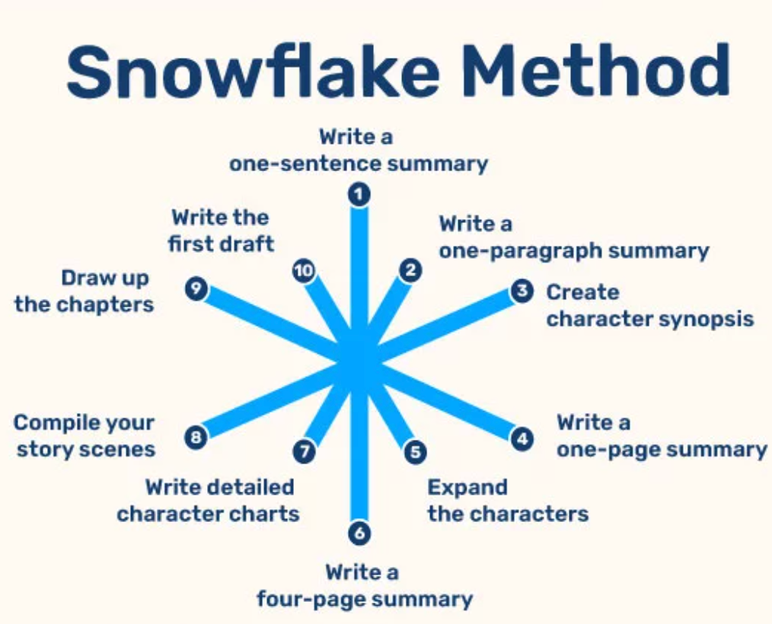

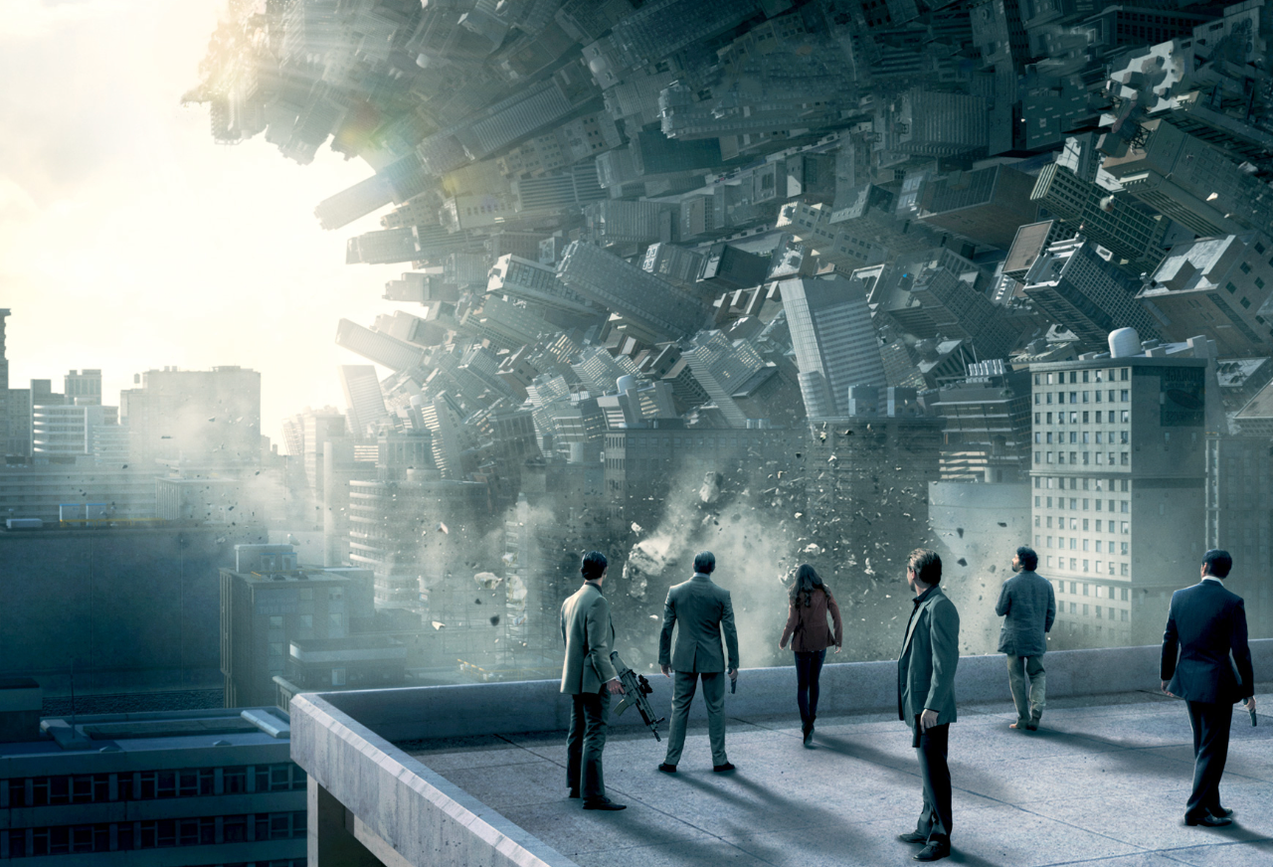
5. The Snowflake Method
It's called the Snowflake Method because it starts with a simple concept and gradually expands it, much like a snowflake begins as a simple shape and becomes more complex as it grows.
Description: Condense your entire novel idea into a single sentence. This is often referred to as the "elevator pitch" and should capture the core of your story. 1. Inception - the exploration of dreams within dreams.
2. Toy Story - toys coming to life when humans aren’t watching

Slide 27
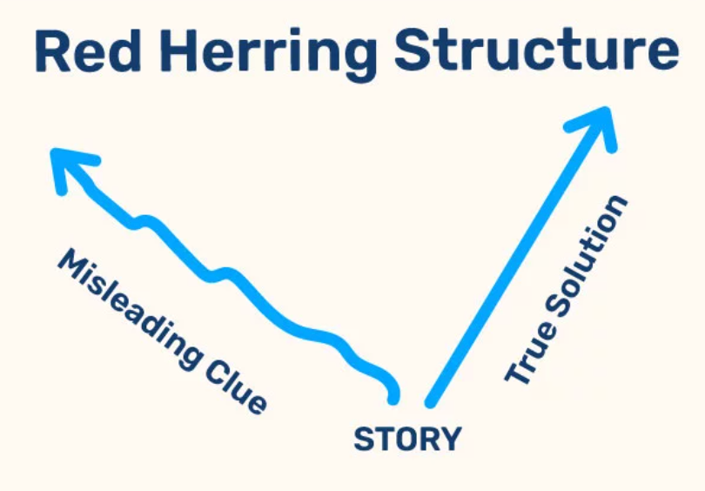
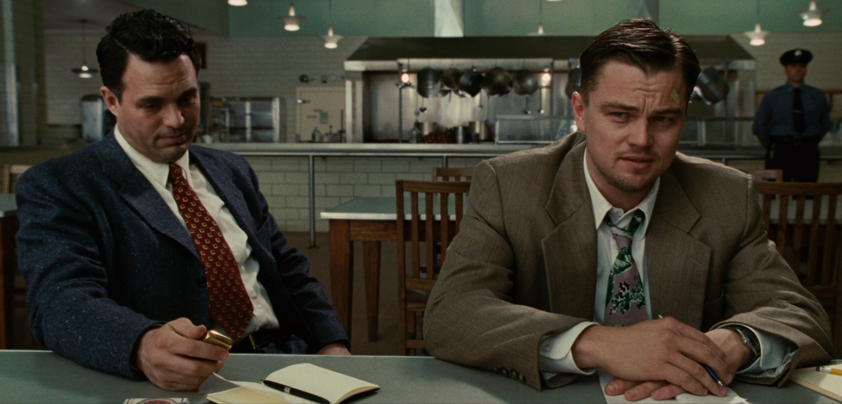
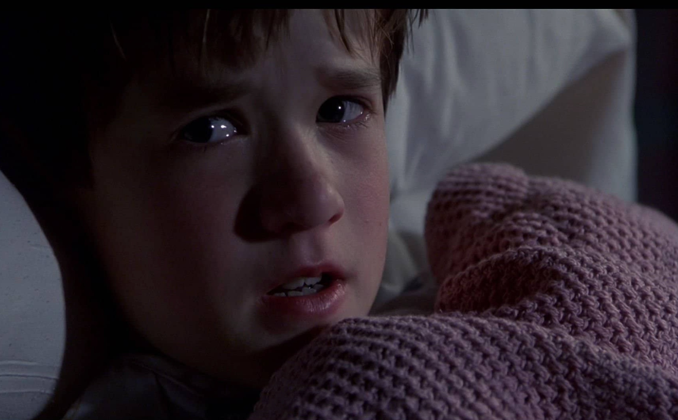
5. Red Herring
A red herring is a narrative device used in storytelling to mislead or distract the audience from the actual plot or truth.
Notes:
1. How Shutter Island Uses Red Herrings:
Misdirection About the Mystery:
The movie makes you believe that the main mystery is about a missing patient and a big conspiracy at the mental hospital. You’re led to think that something shady is going on with secret experiments and mind control. But that’s not the real story.
Making You Suspect the Wrong Things:
The doctors, the strange things happening on the island, and the creepy lighthouse all seem suspicious. The movie makes you think these are clues to solve the mystery. But they’re actually there to distract you from what’s really going on.
The Real Truth Is Hidden:
The red herrings make you focus on the wrong things so that the real truth—about the main character, Teddy, and his past—comes as a big surprise at the end. The movie tricks you into thinking one way, only to reveal something completely different at the end.
Why Use Red Herrings?
The red herrings are used to make the movie more exciting and to keep you engaged. They make the twist at the end more shocking because you didn’t see it coming. The whole time, you thought you were figuring out one mystery, but it turns out the real story was something else entirely.
In short, Shutter Island uses red herrings to keep you on your toes and to make the final revelation much more surprising and impactful. 2. THE SIXTH SENSE
How The Sixth Sense Uses Red Herrings:
Misleading the Audience About Dr. Crowe’s Condition:
Red Herring: The film leads the audience to believe that Dr. Malcolm Crowe, played by Bruce Willis, is alive and functioning normally as a child psychologist. He interacts with his patient, Cole Sear, and seems to go about his life, dealing with his troubled marriage.
Reality: The truth, which is revealed only at the end of the film, is that Dr. Crowe has been dead the entire time. The film uses clever red herrings, such as scenes where he appears to be talking to his wife or Cole's mother, to mislead the audience into thinking he’s alive.
Cole’s “Secret”:
Red Herring: Throughout the film, Cole behaves in a way that suggests his secret is something dark or dangerous, possibly related to violence or mental illness. The audience is led to focus on what might be wrong with Cole, adding tension and mystery.
Reality: The actual secret is that Cole can see and communicate with dead people. The movie hints at more conventional issues (like being troubled or disturbed) to keep the audience from guessing the true nature of his gift.
Why It Works:
These red herrings are effective because they play on the audience’s expectations. By presenting a seemingly ordinary situation and then subtly misleading the audience with false clues, the film creates a shocking twist that completely redefines the story when the truth is revealed at the end. The twist is more powerful because the audience has been carefully misled throughout the entire film.

